Slide 1


Impact of Transformational and Servant Leadership
on Organizational Performance: A Comparative Analysis
LEADERSHIP STRATEGIES

Slide 2

OUR TEAM
Bisma
2021-CS-170
Muhammad Umair
2021-CS-207
Muhammad Yaqoob
2021-CS-118
Ahmed Raza
2021-CS-161

Slide 3
WHAT WE WILL SEE
Introduction
AGENDA
Background
Study Focus
Research Gap
Objectives of Study
Some Theories
Methodology
Author’s Survey
Our Approach
Measurement Scale
Analysis and Findings
Analysis
Framework
Results
Conclusion
Results
Recommendations
Limitations
Future Work

Slide 4


INTRODUCTION
Background
Importance of leadership in the corporate sector.
Ethical leadership styles as a response to global challenges like economic recessions.
Focus on the Study
Comparative analysis of two leadership styles: Transformational and Servant Leadership.
Examination of their impact on organizational learning and performance.
Research Gap
Limited research comparing these two styles in the
profit-oriented service sector.
Call for further understanding of their unique
contributions to organizational success.
Notes:
Imagine you're leading a team, and you want them to perform at their best. Would you focus on inspiring them to achieve great goals, or would you prioritize serving their needs and supporting their growth? This is the key question our presentation will explore today.”Leadership plays a vital role in shaping how organizations perform, especially in today’s competitive world. this study compares two powerful leadership styles: Transformational Leadership and Servant Leadership, to see which one is more effective in driving success.But why is this comparison important? Because organizations today are not just about profits; they’re about balancing performance and people. This study examines how both styles influence organizational learning—the ability to grow and innovate—and how that learning improves overall performance.

Slide 5
INTRODUCTION
Objectives of Study
Evaluate the impact of transformational and servant
leadership on organizational learning.
Assess the influence of organizational learning on organizational performance.
Determine which leadership style is more effective in driving profitability.
Notes:
Speaking Points“This study has three main objectives:
To analyze the impact of Transformational and Servant Leadership on organizational learning.
To measure how organizational learning affects overall performance.
To determine which leadership style—Transformational or Servant—is more effective for maximizing profitability.
In simpler terms, it’s about figuring out which leadership style works best to drive innovation and achieve results.”

Slide 6
Literature Review
Overview of Ethical Leadership
Leadership linked with ethics has long been studied.
Importance of leadership in organizational performance and innovation.
Aspect | Transformational Leadership | Servant Leadership
Primary Focus | Goal-oriented leadership | Service and follower development
Innovation | Promotes innovation via intellectual stimulation | Promotes learning through follower support
Organizational Impact | Strongly linked to goal attainment and Performance | Strongly linked to employee well-being and long-term development.
Notes:
Let me break it down for you. Transformational leaders inspire their teams through big-picture thinking and innovation. They’re like visionaries who encourage their followers to align with organizational goals and think creatively to solve problems.On the other hand, Servant leaders focus on their team’s personal growth and well-being. These leaders prioritize service over authority, creating a nurturing environment where people feel valued and supported.

Slide 7



Research Basis
Foundational Theories
Promotes organizational learning through
problem-solving and intellectual stimulation.
Encourages alignment with organizational
goals (Senge, 1990).
Transformational Leadership
Servant Leadership
Focus on followers' development fosters organizational learning (Bass, 2000).
Notes:
Transformational Leadership (Senge, 1990):This theory emphasizes inspiring and motivating teams to solve problems creatively and align with the organization’s goals. Servant Leadership (Bass, 2000):This theory highlights the importance of leaders prioritizing their team members’ growth and development.

Slide 8
Literature Review
Research Gap
Limited empirical evidence
Limited empirical evidence comparing transformational and servant leadership styles in for-profit organizations.
The Paper addresses
The mediating role of organizational learning.
Differences in leadership effectiveness concerning profitability.
Notes:
While there has been a lot of research on leadership styles like transformational and servant leadership, most of it focuses on their general impact on organizations. However, there isn’t enough work exploring how these leadership styles specifically promote organizational learning. In simpler terms, we know these leaders inspire teams and support their growth, but how exactly they help organizations learn and adapt better—this is still not fully understood. That’s the gap this study aims to address.

Slide 9





METHODOLOGY
Study Objective
Examine the impact of transformational and servant leadership in profit-oriented service sectors.
ORIGINAL AUTHOR'S SURVEY
Population
Service sectors in Pakistan, including:
Hotels
Telecommunication companies
Banking sector
Sample
400 respondents surveyed, 155 responses analyzed.
Respondents: Primarily line managers; a few top executives included.
Sampling
Technique: Non-probability judgment sampling.
Selected based on expertise in leadership styles and direct impact by leadership behaviors.
Data Analysis
Tools Used:
SPSS
AMOS
Research Design:
Method: Quantitative approach with a structured questionnaire.
Type: Descriptive research study.
Survey: Conducted through personally administered questionnaires.

Slide 10
METHODOLOGY
Study Objective
Examine the impact of transformational and servant leadership in profit-oriented service sectors.
OUR
APPROACH
Population
Service sectors in Pakistan, including:
Hotels
Telecommunication companies
Banking sector
Option if someone is from other sector
Sample
Approximately 40 responses and almost all were analyzed.
Respondents: Primarily Job holders in top notch Software Houses.
Sampling
Technique: Non-probability judgment sampling.
Selected based on expertise in leadership styles and direct impact by leadership behaviors.
Survey Method
Conducted via Google Forms.
Questionnaire
Used the same questions as in the original study.
Based on established scales

Slide 11





MEASUREMENT SCALE
SCALE TYPE
Five-point Likert scale:
1 = Strongly Agree, 5 = Strongly Disagree.
VARIABLES
MEASURED
Transformational Leadership
Servant
Leadership
Organizational
learning
Organizational
performance
Scale based on Morales et al. (2008), with 4 items.
Scale based on Jacobs (2006), with 9 items.
Scale based on Morales et al. (2008), with 4 items.
Scale based on Morales et al. (2008), with 4 items.

Slide 12
Analysis and Findings
Ethical leadership styles continue to evolve and influence organizational performance
No single leadership style is universally the most effective for superior performance
Improves knowledge transfer and absorptive capacity, leading to enhanced performance
Demonstrates a stronger positive relationship with organizational learning
Notes:
the key findings about leadership and its impact on organizations.
First, ethical leadership is continuously evolving, and it plays a major role in improving how organizations perform. Leaders who focus on ethics create a positive work environment that helps everyone grow.
Second, there's no single 'perfect' leadership style. Different situations call for different approaches, so flexibility is important.
Third, strong leadership improves knowledge-sharing within a team. This helps organizations adapt better and enhances their overall performance.
Lastly, ethical leadership creates a positive relationship with organizational learning, meaning teams are more open to change and growth, which leads to long-term success.
In short, leadership isn't one-size-fits-all, but ethical and adaptable leaders can make a huge difference in achieving great results."

Slide 13
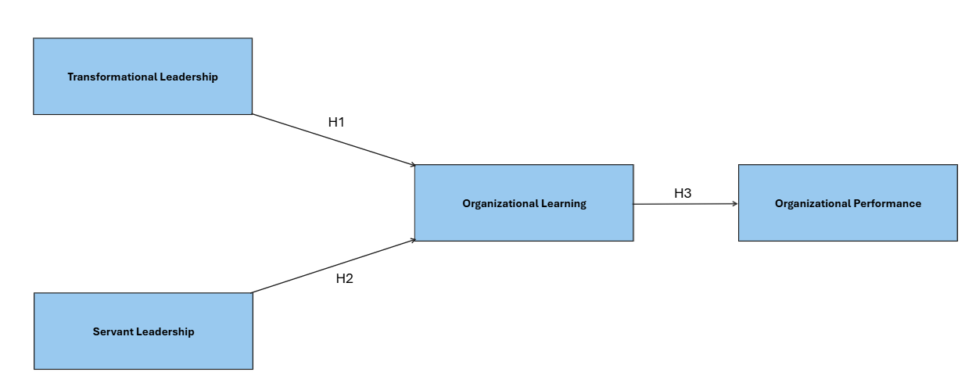
Framework
Leadership styles impact on OP with mediating effect of OL
Notes:
This framework shows the connection between leadership styles, organizational learning, and organizational performance.
Transformational Leadership and Servant Leadership are the two key leadership styles being analyzed.
Transformational Leadership (H1) focuses on inspiring and motivating employees to achieve more.
Servant Leadership (H2) emphasizes serving employees and their needs to help them perform better.
Both leadership styles influence Organizational Learning, which is the ability of the organization to learn, adapt, and grow from experiences.
Finally, Organizational Learning (H3) directly impacts Organizational Performance, meaning how well the organization achieves its goals, efficiency, and success.
The framework highlights that leadership styles indirectly improve organizational performance by enhancing learning processes within the organization.”

Slide 14
Demographic Results
Meta | Researchers | Ours
Gender
Male | 107 | 22
Female | 48 | 16
Age
Below 35 | 141 | 33
35-50 | 9 | 4
50 above | 5 | 1
Income Level
Less than 10,000 | 14 | 5
10,000-50,000 | 129 | 16
50,000 above | 12 | 17
Education
Below or High | 3 | 0
College graduate | 6 | 8
University Graduate | 146 | 30

Slide 15
Results
Measures | Researchers | Ours
Transformational Leadership | 2.2581 | 3.125
Servant Leadership | 2.5520 | 2.999
Organizational Learning | 2.3403 | 2.981
Organizational Performance | 2.3839 | 2.770

Slide 16
Pearson Correlation
Measures | Researchers | Ours
Transformational Leadership – Servant Leadership | 0.549 | 0.1464
Transformational Leadership – Organizational Learning | 0.664 | 0.2576
Servant Leadership – Organizational Learning | 0.580 | 0.6287
Organizational Learning – Organizational Performance | 0.617 | 0.6973
Notes:
Pearson correlation test is used to check the correlation
among all the variables, especially two independent variables.
Pearson correlation -1 to 0 is negative correlation, 0
no correlation, and 0 to ?1 positive correlation. ?1 is
perfect correlation.

Slide 17

CONCLUSION
Results of Study
Both transformational and servant leadership impact organizational learning and performance.
Transformational leadership has a greater influence on organizational learning than servant leadership.
Empirical evidence supports the mediation role of organizational learning between leadership styles and performance.

Slide 18
RECOMMENDATIONS
Organizations should foster a leadership style that enhances organizational learning to drive performance.
Leadership development programs should focus on cultivating qualities of both transformational and servant leadership.
Implement periodic training sessions to reinforce the principles and practices of effective leadership styles.

Slide 19
LIMITATIONS
The study's findings are primarily applicable to profit-oriented service sectors and may not generalize to non-profit or manufacturing sectors.
The research was limited to specific regions and cultural contexts, which may affect the applicability of the results in different global contexts.
Sample size and response rates may limit the generalizability of the conclusions.

Slide 20
FUTURE RESEARCH
Further research is needed to explore these leadership styles in non-profit and manufacturing sectors.
Examine the long-term effects of transformational and servant leadership on organizational culture and employee development.

Slide 21

THANK YOU
LEADERSHIP STRATEGIES

